Slide 1

MY HOUSE RUNS .NET
Smart Home Automation with .NET Core and Azure
Senior Content Developer, Microsoft

Slide 2
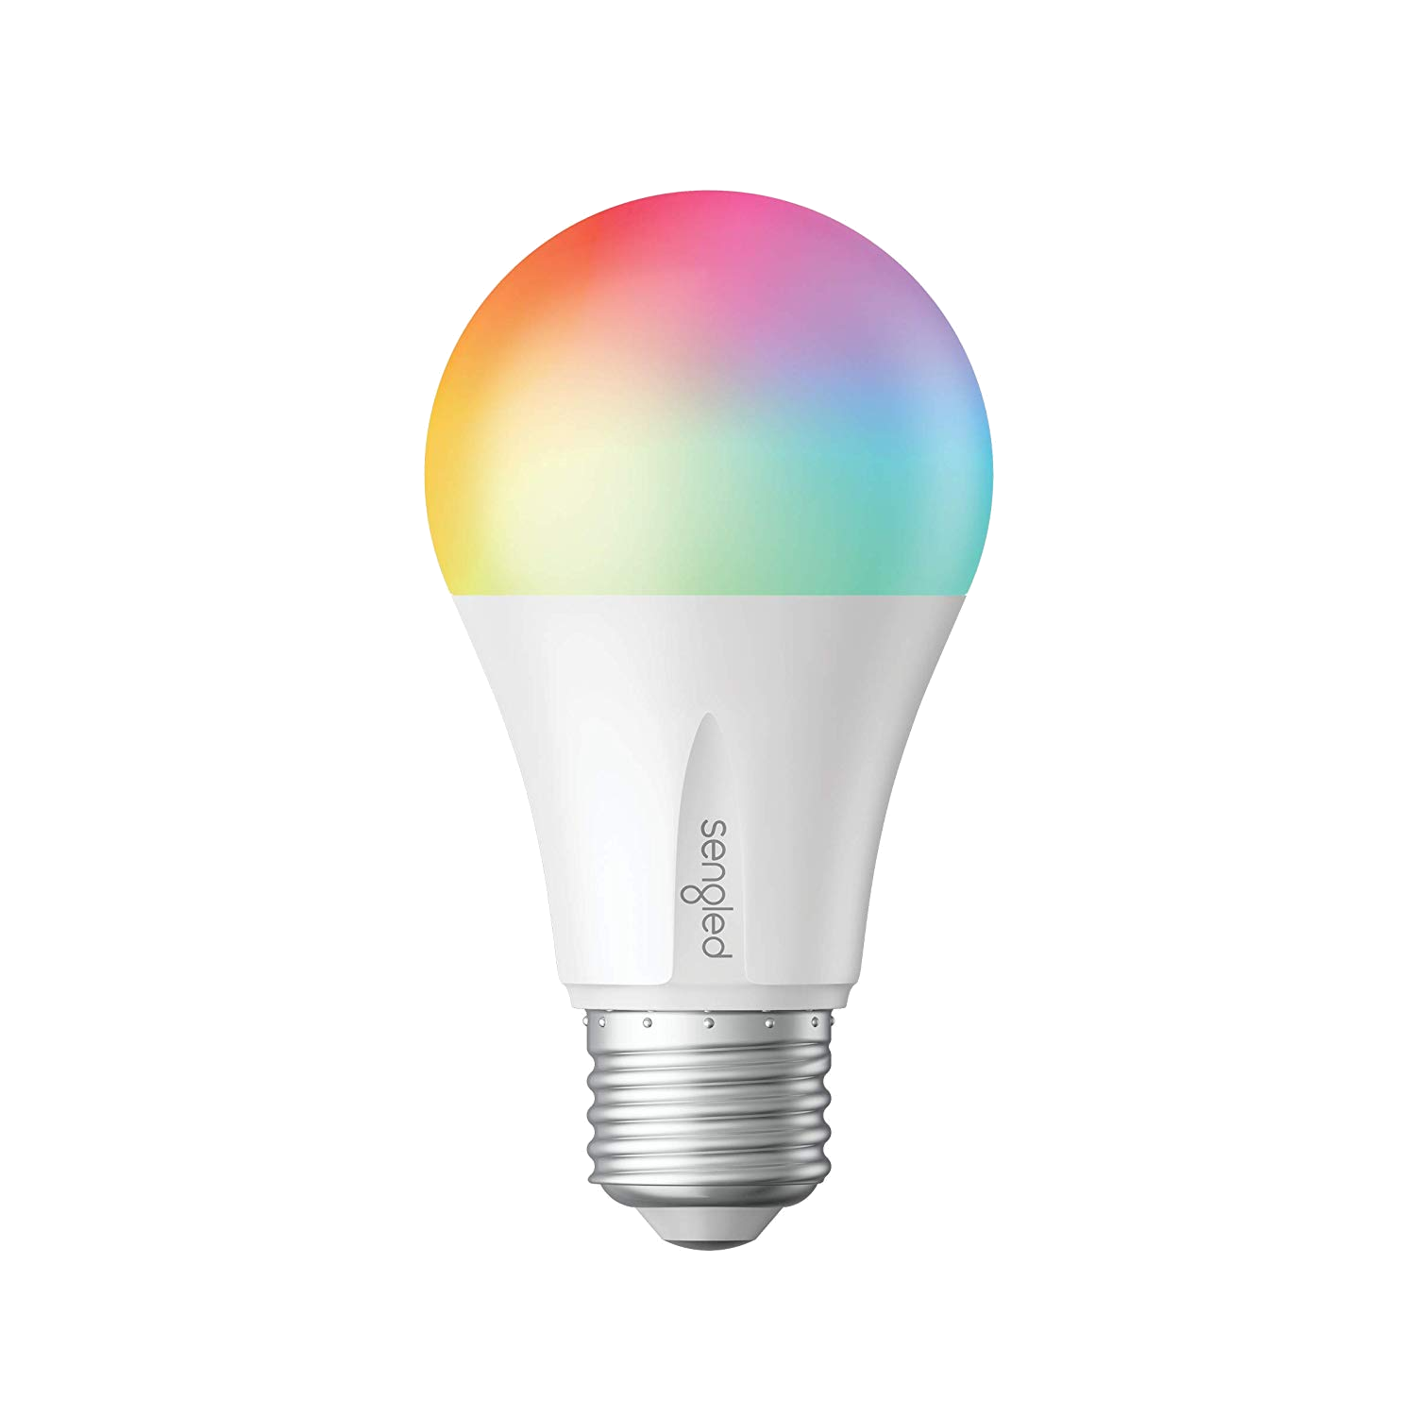
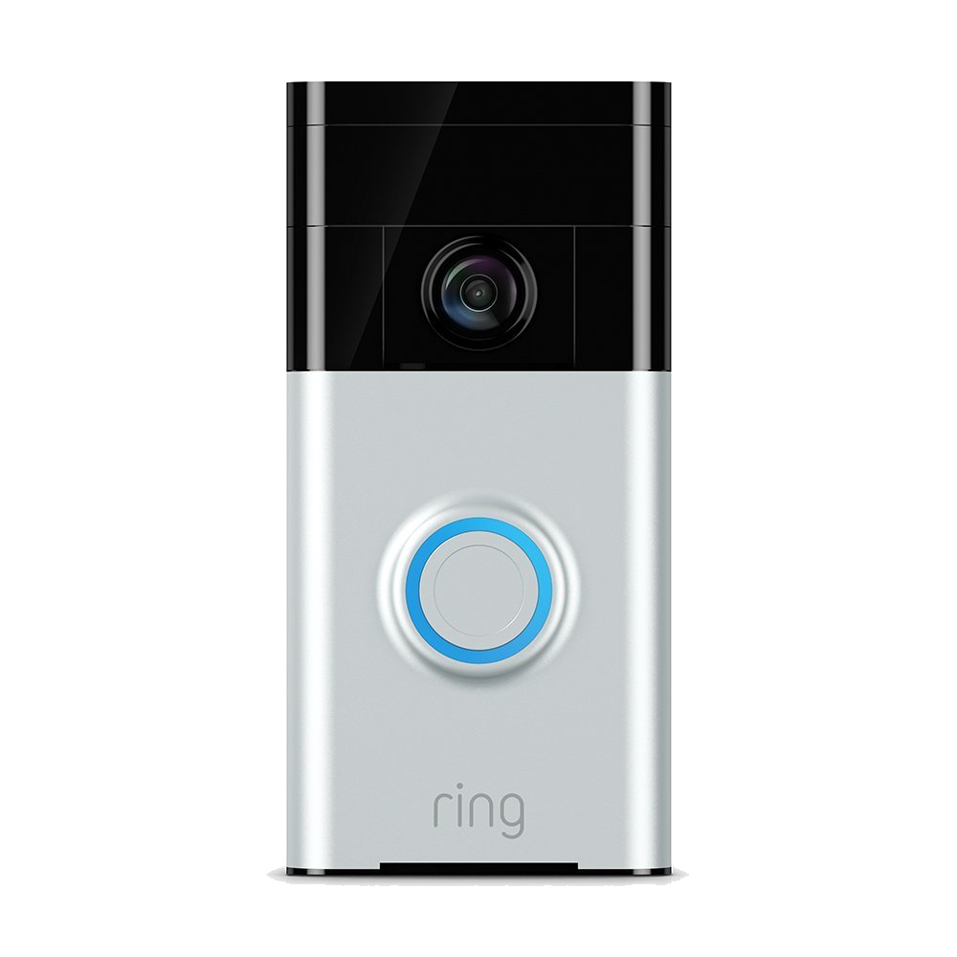
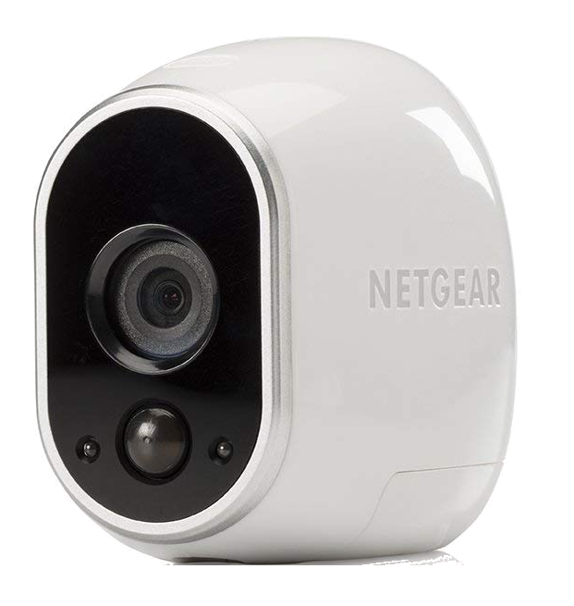
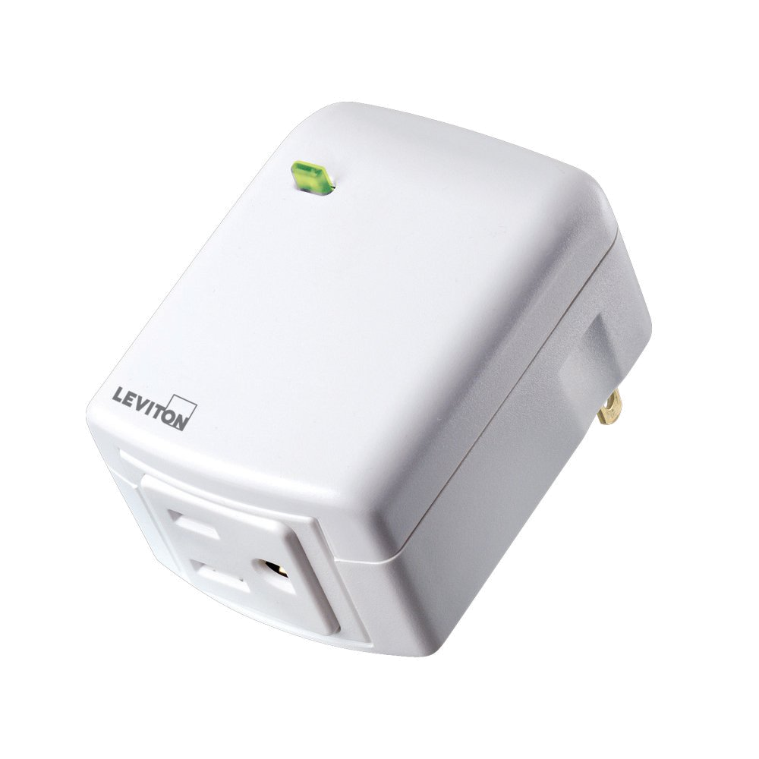
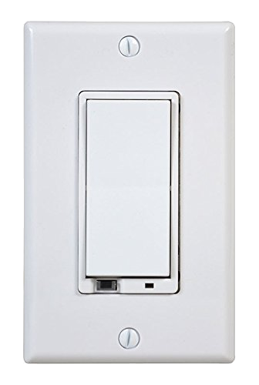
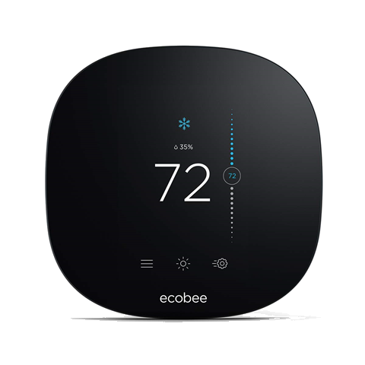
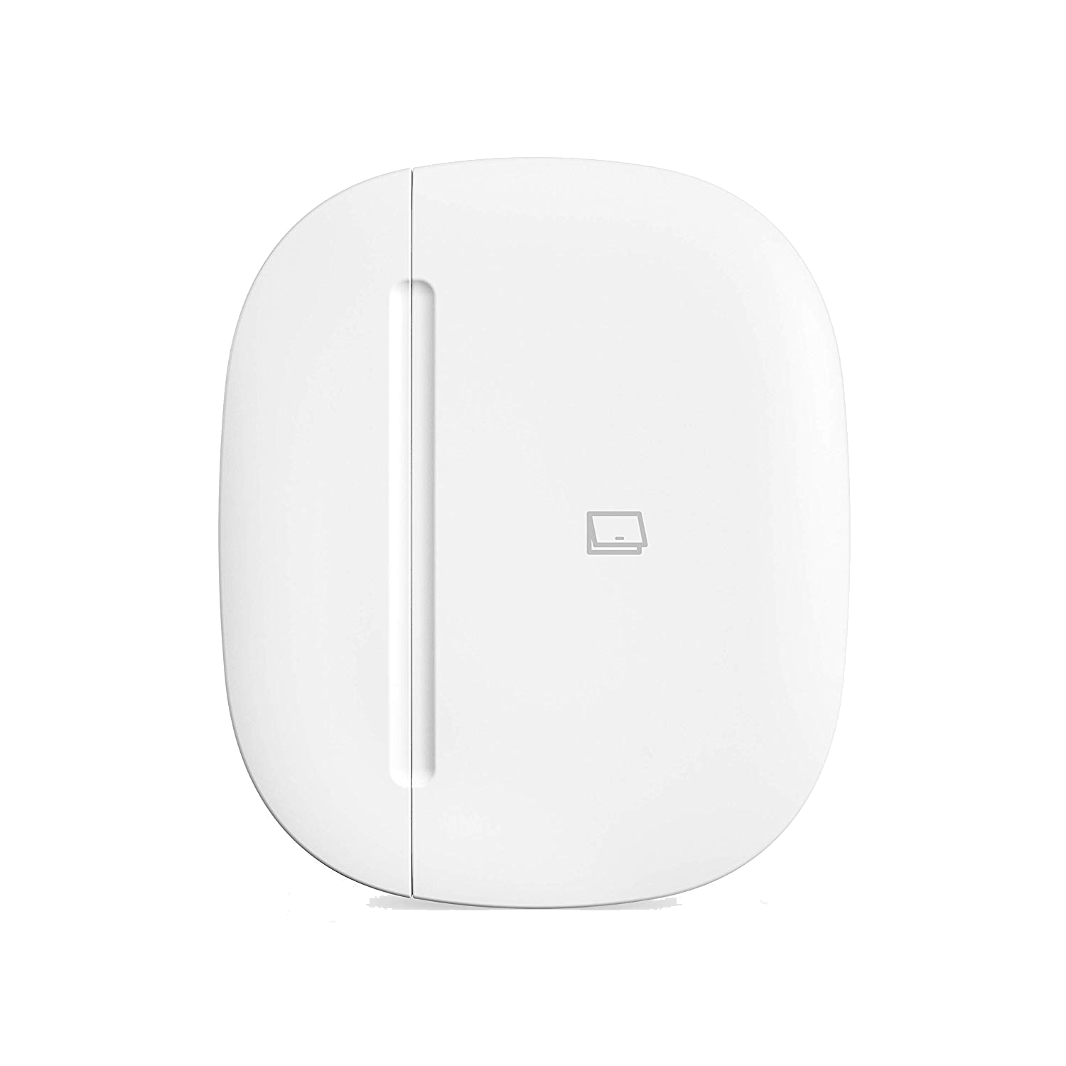
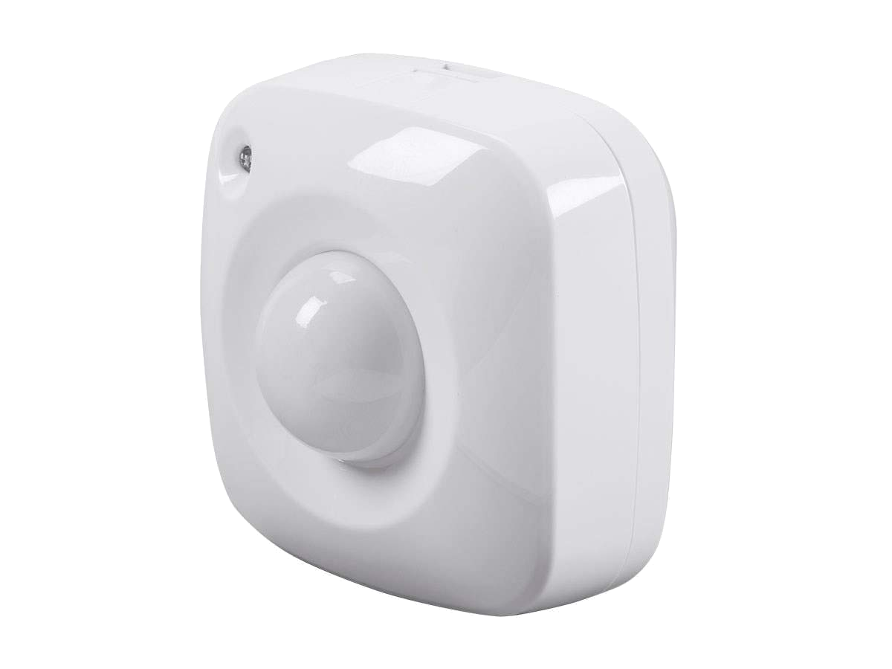

Slide 3


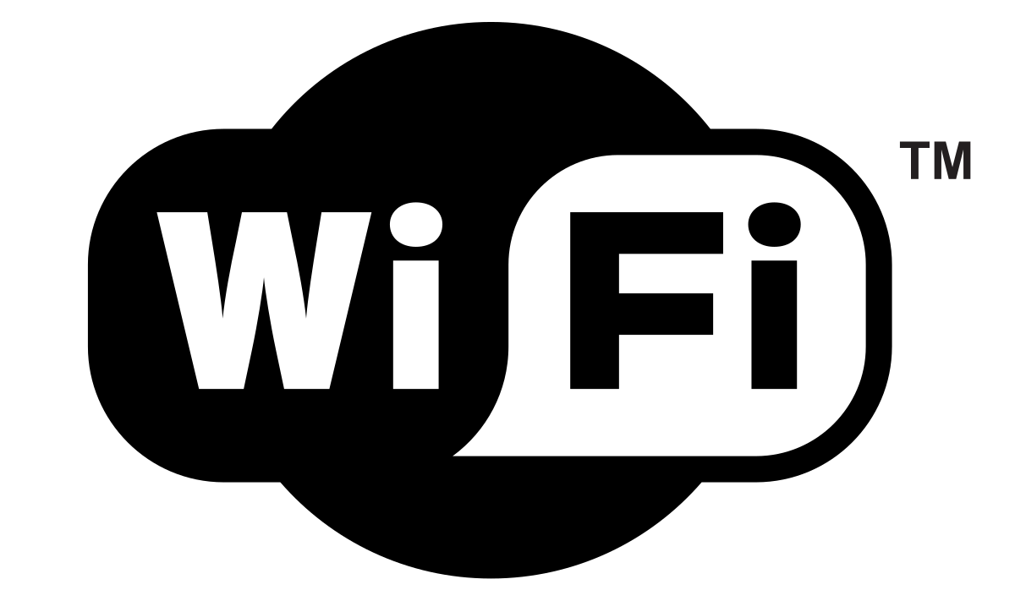
Notes:
Protocols
WiFi
Pros: Familiar, ubiquitous
Cons: Power hungry, not purpose-built
Z-Wave
Pros: Purpose-built, low power, 900 Mhz
Cons: Relatively obscure, proprietary (Z-Wave)
Zigbee
Pros: Purpose-built, low power, IEEE standard (Zigbee)
Cons: Relatively obscure, 2.4 Ghz spectrum (Zigbee)

Slide 4

Why you want a home automation hub
Integrates TCP/IP, Z-Wave, and Zigbee
Centralized automation in response to:
Time
Presence
Sensors
AI assistant integration
Remote access
API

Slide 5
I chose Samsung SmartThings…
Pros:
Market support
Open source community
GitHub integration
Cons:
Obscure programming language
Tooling
No debugging
Cloud execution

Slide 6
…but then migrated to Hubitat Elevate
Pros:
Similarity to SmartThings
Local execution
Cons:
Similarity to SmartThings
Porting code from SmartThings

Slide 7
Hubitat Elevate’s super easy API
Notes:
Demo Maker API and Event Socket

Slide 8
Inspiration struck!
Notes:
I realized that I could use .NET Core to build a framework around the Maker API and Event Socket. This would enable me to use .NET’s mature tools like Visual Studio, give me full debugging support, enable me to consume NuGet packages, and give me a platform on which I could build anything I could imagine.

Slide 9

PUPPET

Slide 10
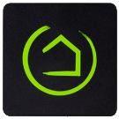


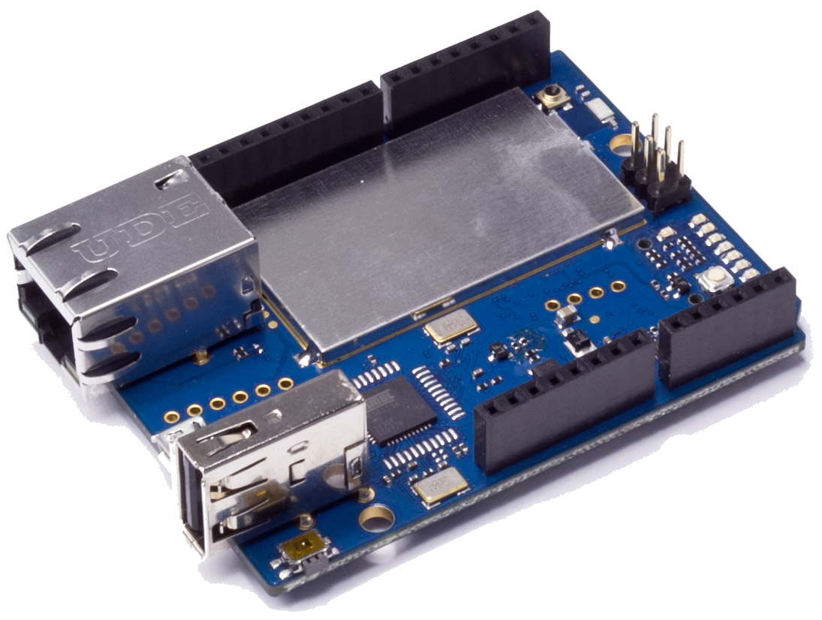
Front Door: open
Front Door: close
Puppet
Puppet.Automation.FrontDoorStuff
WebSocket

Slide 11
Building a garage door module
Values
open
Closed
Opening
closing
Commands
open()
close()

Slide 12
close()
Virtual Garage Door
CLOSING
CLOSED
OPEN
Puppet
Contact Sensor
CLOSED
OPEN

Slide 13
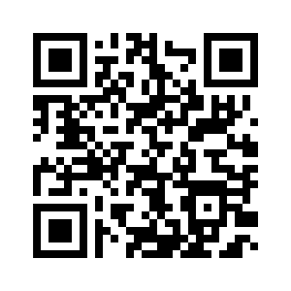



@CamSoper CamSoper
http://github.com/CamSoper/puppet

